Slide 1
Scaling Financial Transaction using 0MQ and JSON
Moving from 03 -> 11 -> 14 and other learnings.

Slide 2

Background and History
Started developing in C++ in 1998 with Borland C++ Builder
Financial Simulations in C++/MFC until 2016.
Been working with C++ and in Linux since then for EPX.
North American Bancard acquired EPX in 2014
We process over $50 billion dollars a year in transactions.

Slide 3
Housekeeping and Disclosures
Definitely a lessons learned talk.
Map of transactions and how they flow.
As a development group we choose smaller (header only, or similar) stable open source libraries.
0MQ is primarily C, however we use the the CPPZMQ interface.
I/We are not 0MQ(ZMQ) Experts
Our backend libraries are C++.
There are open standards on Credit Cards such as the EMV standard.
http://emvco.com
No PCI Compliance issues here.
Notes:
Small libraries we can learn to use, adapt or fix ourselves if needed. Also from a security.

Slide 4
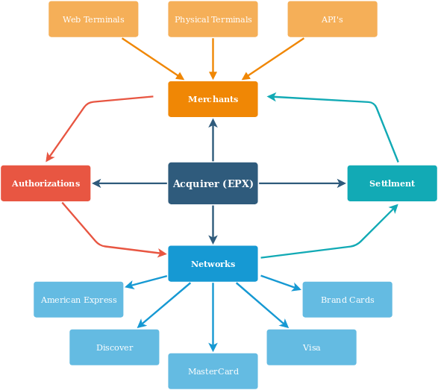
Building for Scalability Breadth, Speed, Stability
Moving parts of the Processing System.
Many have their own protocol. EBCDIC anyone?
Some are old, some are new, some are BETA.
Card standards have more specifications then code.

Slide 5
The Legacy -> Moving Forward
PowerBuilder
Windows Based A/B Redundancy
Normalization anyone?
Almost never good to rewrite, but sometimes that's what has to be done for longevity of a product or line of business.
Technical debt is due to outdated language tools and legacy implementations.
Must prevent new bugs as much as possible however its a rewrite in small testable checks.
Testing is key to finding newly implemented bugs!

Slide 6

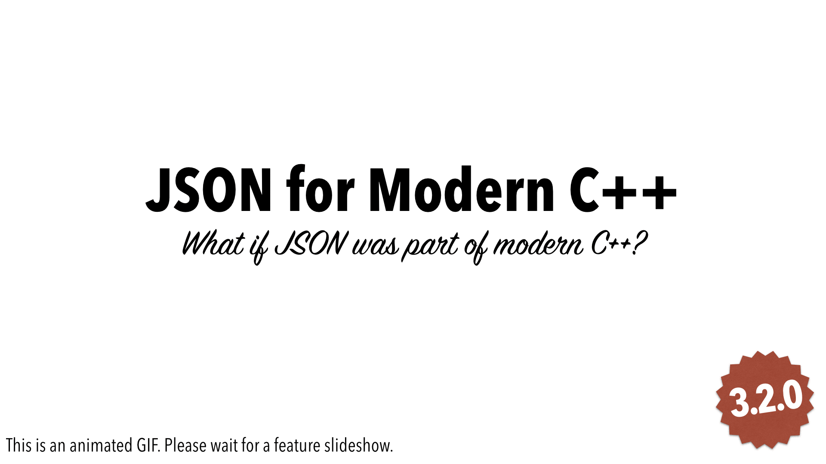
The Tech: 0MQ & JSON
Instead of Sockets and XML
Why 0MQ
  Stability
  Brokerless
  C0MQ / CPPZMQ
Why JSON (instead of XML)
  Readability
  Portability
  Size
Other Synergies
  0MQ uses char* by default.
  Oracle OCCI and data buffers; everything can be a string.
Notes:
Higher throughput then tcp - Avoiding redundant networking stack traversals improve throughput significantly. Sending two messages down the networking stack in one go. This technique is known as message batching. 0mq delivers blobs of data (messages) to nodes. Map nodes to threads, processes, or nodes. Single socket API to work with, no matter the transport (like in-process, inter-process, TCP, or multicast). automatically reconnects to peers. queues messages at both sender and receiver, as needed. Limits queues to guard against out of memory. handles socket errors. All I/O in background threads. lock-free techniques talking between nodes, never locks, waits, semaphores, or deadlocks.

Slide 7


Default Compiler, Oracle and ABI
To move forward we needed a C++ 11 compiler.
CentOS6 by default didn’t have one.
In our makefile you will find:
CXX = g++ -D_GLIBCXX_USE_CXX11_ABI=0
Oracle upgrade caused ABI issues.

Slide 8
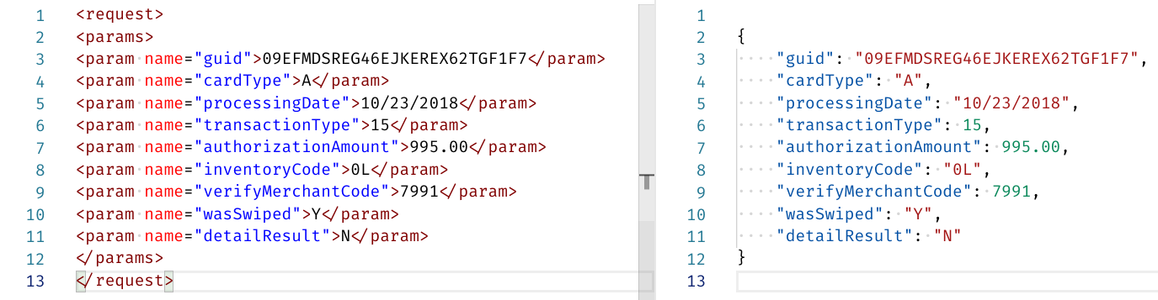
How much smaller is the JSON?
413 vs 262 = 35% reduction
Notes:
413 vs 262 = 35% data reduction.

Slide 9
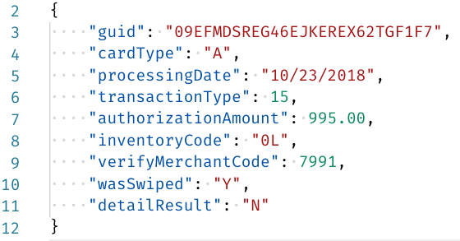
Benefits of JSON for Modern C++
Requires only C++ 11
Header only.
Easy to read and use.
JSON Portability; BSON in BETA
Better type management.
https://github.com/nlohmann/json

Slide 10
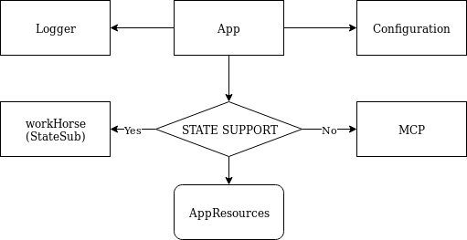
Application and Class Layout
Notes:
App class also pulls in and references some of our base ZMQ implementation.

Slide 11
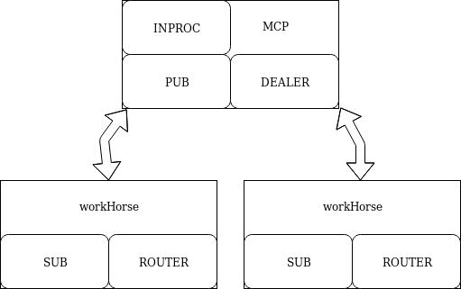
0MQ and the Patterns
DEALER/ROUTER
PUB/SUB
INPROC

Slide 12
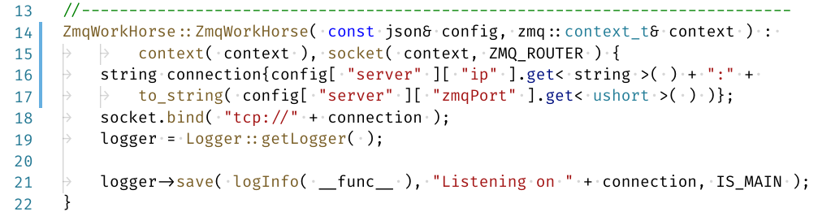
0MQ - ROUTER of DEALER/ROUTER
Notes:
synchronous (REQ and REP), and asynchronous (DEALER and ROUTER), which may be mixed in various ways
http://zguide.zeromq.org/page:all#advanced-request-reply

Slide 13
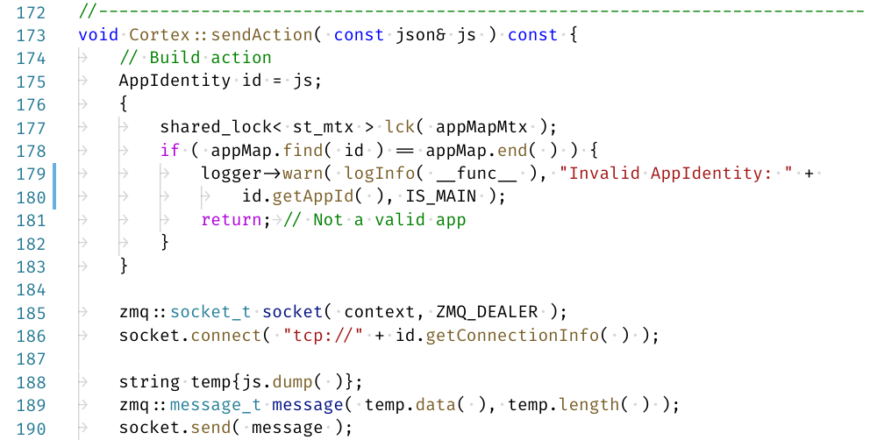
You have become better at C++ (14)
Notes:
st_mtx = shared_time_mutex; using at top of file.

Slide 14
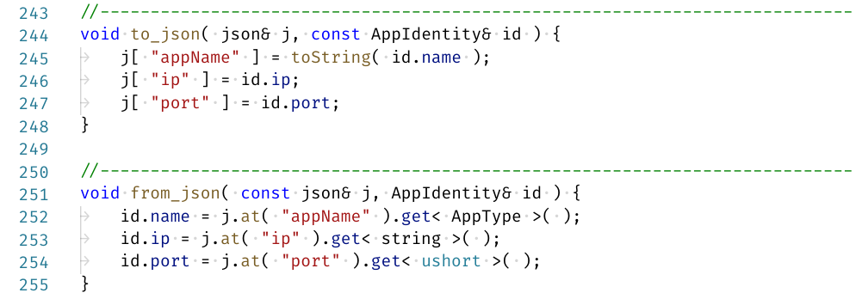
To and From JSON
Notes:
When calling the json constructor with your type, your custom to_json method will be automatically called. Likewise, when calling get<your_type>(), the from_json method will be called. Has to be in your namespace, available (included headers) and default constructible.

Slide 15
0MQ and the Patterns
DEALER/ROUTER
PUB/SUB
INPROC

Slide 16
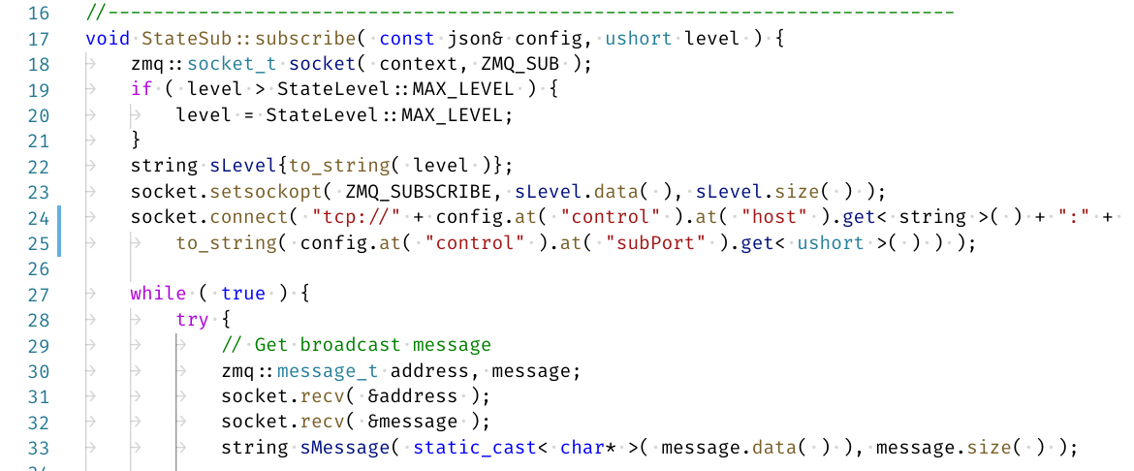
0MQ - SUB of PUB/SUB

Slide 17
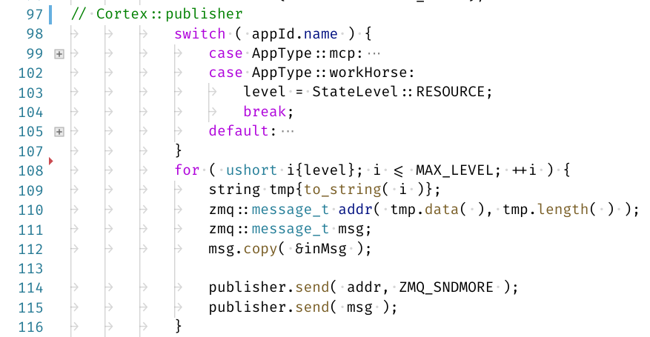
0MQ - PUB of PUB/SUB

Slide 18
0MQ and the Patterns
DEALER/ROUTER
PUB/SUB
INPROC

Slide 19
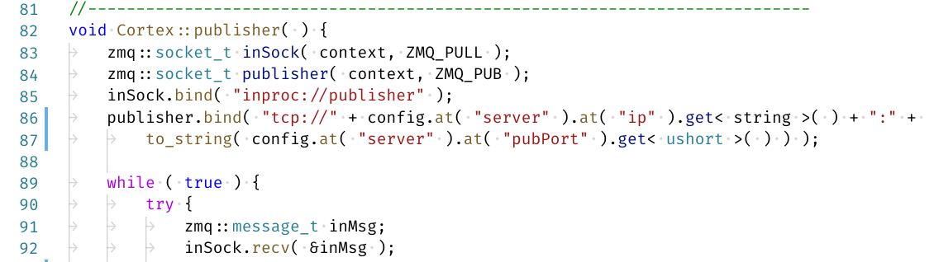
INPROC Example
Notes:
Starts in a thread with app startup.

Slide 20
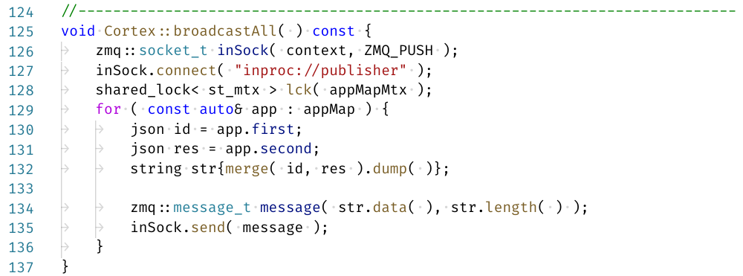
INPROC Send
Notes:
Merge is another json helper we have to flatten and merge two json types.

Slide 21
0MQ and the Patterns
DEALER/ROUTER
PUB/SUB
INPROC
DEMO

Slide 22

Performance Improvements
DB Caching Application - 90 minute update down to 10 minutes.
Authorization Transfer - 5x speed-up
Encrypt/Decrypt Routines - 3x speed-up
Platform Redundancy and Scalability
Notes:
Not using Windows is already a speed increase right?

Slide 23
Code, Slide and Thanks
https://github.com/kevinbcarpenter/jz18sub
Kent Glenn, Jeff Jacob, Mithu Gansen, Jermey Daley

